Slide 1
Advanced Web Programming
Faculty: Elizabeth George

Slide 2
Browsers
Your options

Slide 3
EDITORS

Slide 4
Examples
TextEdit
Brackets
Visual Studio Code
Notepad
Sublime

Slide 5
HTML Methods
GET: retrieve information from the given server using a given URI. Requests using GET should only retrieve data and should have no other effect on the data.
HEAD: Same as GET, but transfers the status line and header section only.
POST: This request is used to send data to the server, for example, customer information, file upload, etc. using HTML forms.

Slide 6
HTML Methods (contd.)
PUT: replaces all current representations of the target resource with the uploaded content.
DELETE: removes all current representations of the target resource given by a URI.
CONNECT: Establishes a tunnel to the server identified by a given URI.
OPTIONS: Describes the communication options for the target resource.
TRACE: Performs a message loop-back test along the path to the target resource.

Slide 7
HTTP
Hypertext Transfer Protocol (HTTP) is an application-layer protocol for transmitting hypermedia documents, such as HTML.
It was designed for communication between web browsers and web servers, but it can also be used for other purposes

Slide 8
HTTPS
=
HTTP + SSL

Slide 9
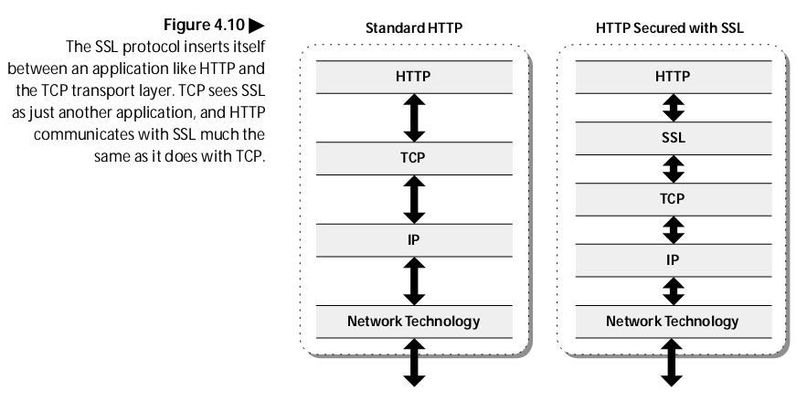
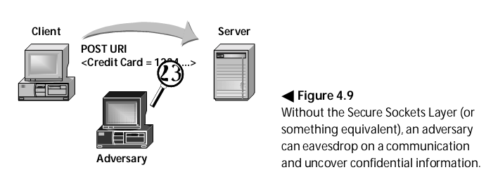
HTTPS
(HTTPS) Hypertext Transfer Protocol over Secure Socket Layer (SSL).
First implementation of HTTP over SSL was issued in 1995 by Netscape.

Slide 10
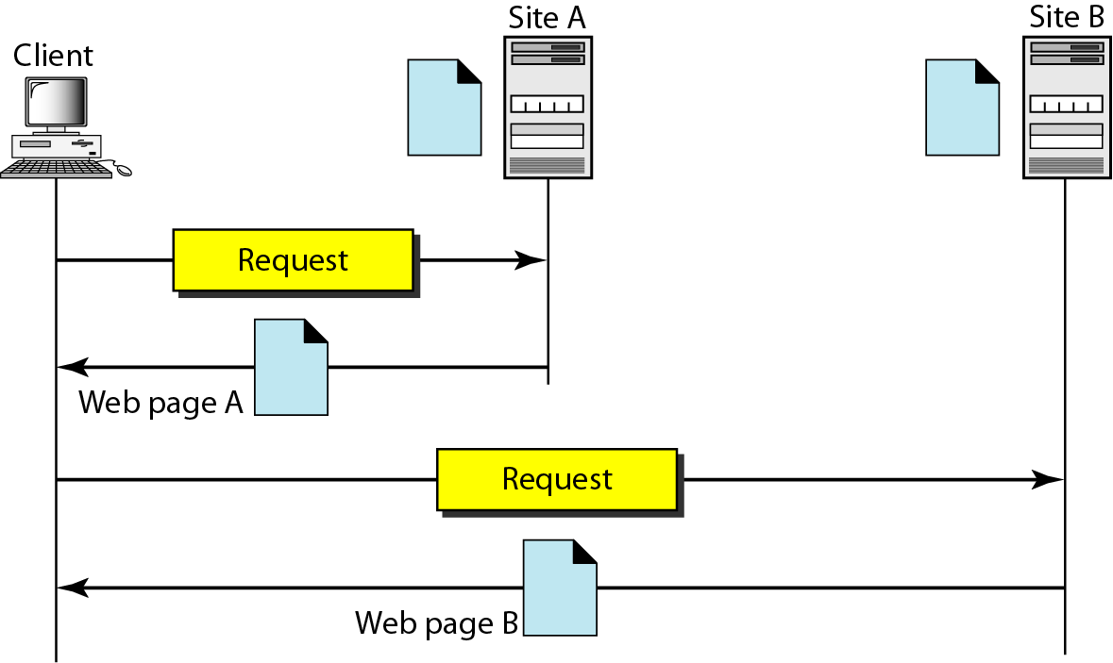
Architecture of the Web

Slide 11
Document Object Model (DOM)
Writing clean code

Slide 12
The Document Object Model (DOM)
Basis of HTML5 is “New features should be based on HTML, CSS, the DOM, and JavaScript…”
DOM provides common tree-like structure that all pages should follow
Computer Scientists love trees (the mathematical kind) because you can test them.

Slide 13
HTML is built on the DOM
z
Document
Root element
<html>
Element
<head>
Element
<body>
Element
<title>
Attribute
“href”
Element
<a>
Element
<h1>
Text
“my title”
Text
“my link”
Text
“my header”
Adapted from w3Schools.com

Slide 14
Three parts of a well-formed document
Doctype
Version of HTML that you will be using
Head
Metadata
Body
Displayable content

Slide 15
Doctype
HTML5
<!DOCTYPE html>
Previous versions dictated backwards compatibility
<!DOCTYPE HTML PUBLIC "-//W3C//DTD HTML 4.01//EN" "http://www.w3.org/TR/html4/strict.dtd">
<!DOCTYPE HTML PUBLIC "-//W3C//DTD HTML 4.01 Transitional//EN" "http://www.w3.org/TR/html4/loose.dtd">

Slide 16
Head
Additional information used by the browser
Meta data – language, title
Supporting files – JavaScript, Styling, Add-ons
Other than title, meta-data is not displayed

Slide 17
Body
Bulk of your page
Important to write well-formatted (tree-like) code.
Most of the content is displayed by the browser, but there may be some meta-data too

Slide 18
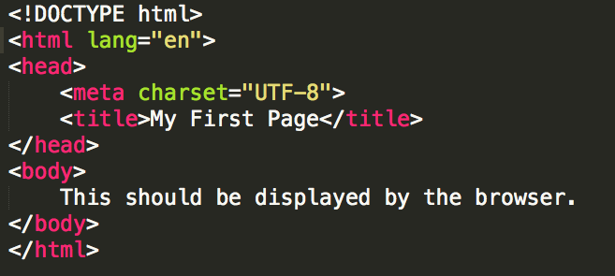
Example
Example: template.html

Slide 19
Validate the Code
go to www.validator.w3.org

Slide 20
HTML5 Tags and Syntax

Slide 21
HTML tags Im going to disappoint you a little bit
I can’t teach you all of the tags
I can’t teach you all of the tags
You don’t want me to teach you all of the tags

Slide 22
Finally, some tags…
Tags have a beginning and an end
Some tags have attributes (src, href, etc..)
<h1>Hello World</h1>
Start tag
Closing tag
<img src=‘’x.gif” />
Self-closing tag

Slide 23
Display
One of the most important attributes of an element is its display. The two most common are block and inline
block (can take width and height)
Newline is inserted before and after, e.g. it “Takes up” whole width
inline (can not take width and height)
Only uses as much space as needed to contain the element.

Slide 24
Common Tags
Headings (block)
<h1>, <h2>, <h3>, <h4>, <h5>, <h6>
These tags have syntax and semantics
Paragraphs (block)
<p> …. </p>
Should only contain inline elements
Divs (block)
<div>...</div>
Generic section that is larger than a paragraph
Read the notes section
Notes:
the semantics are, things that are in an h1 tag have much higher importance than things that are in an h5 or h6. And this is very important for people who are using screen readers. If you start throwing h3 tags and h2 tags all over the place just because you want them to be a little bit bigger and bolder, it's gonna be very confusing
It's also block, and inside of it you can only contain other inline elements. So you can put a lot of text, a lot of pictures and things like that, but you should never put a paragraph inside of a paragraph or even, you should never put a heading inside of a paragraph.

Slide 25
More tags
Try the List tag from w3schools
https://www.w3schools.com/html/html_lists.asp
Line breaks
<br>

Slide 26
Attributes
Attributes provide additional information
about an element
Always specified in the start tag
Attributes come in name/value pairs

Slide 27
Images
Images (inline)
<img src = “myPicture.jpg” alt = “Image of Colleen”/>
Images rarely work the first time
Show a broken link, too big, too small, etc.
Save yourself heartache and size/carefully name your picture before you use it.

Slide 28
Images
<img src=”logo.jpg”
alt="company logo"
title = "AAA1 LLC"
class = "thumbnail"/>
Image filename
Info for screen readers, broken links
Displays on hover
Extra formatting (height, width, position, etc.)

Slide 29
More Attributes
As you learn the tags, you learn their specific attributes. Some apply to any tag
class – applies special properties to groups of elements
id – specifies a unique id to one element on the page
style – specifies a certain visual style
accesskey – a shortcut key to activate an element
tabindex – the order elements will come into focus using the tab key.

Slide 30
Special Entities
Tags always start with a bracket (<)
What if you want the browser to display a bracket, not start a tag?

Slide 31
Special Entities
If you want…. | Then use…
< | &lt;
> | &gt;
© | &copy;
blank space | &nbsp;
¢ | &cent;
& | &amp;

Slide 32
Semantic HTML5 Tags
Making the most of the new tags

Slide 33
How to Design
The most important step in web design is the design.
You need a clear picture of what you want to create, before you can begin coding.

Slide 34
How to Design
Try out these tags
<header>
<section>
<aside>
<article>
<footer>

Slide 35
Using Semantic Tags
In the beginning (insert dramatic music of your choice…) there was div
<div> was a way to group related content together
Divs almost always had special classes/ids associated with them
<div class = “header”>…</div>
<div class = “section”>…</div>
<div class = “footer”>…</div>

Slide 36
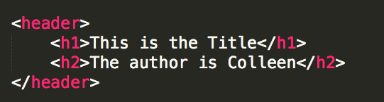
<header>
A group of introductory or navigational aids: title, navigation links, etc.
Not to be confused with <head> or the different headings.

Slide 37
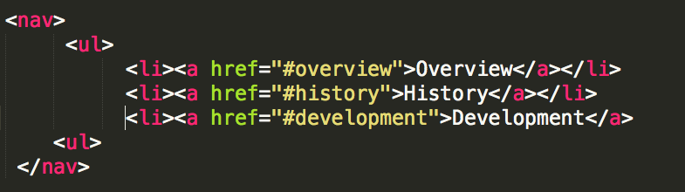
<nav>
A section of the page that links to other pages or to parts within the page.
Often found in the <header> tag

Slide 38
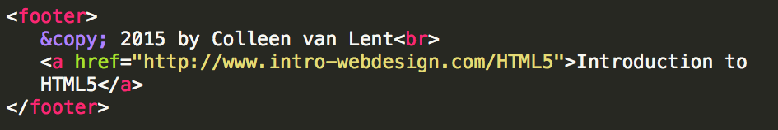
<footer>
A section that contains info such as copyright data, related documents, and links to social media
Typically at the bottom of the page, but not required.

Slide 39
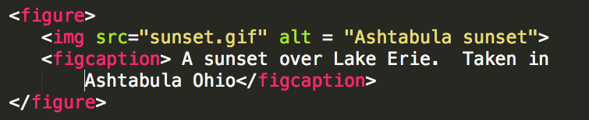
<figure>
More semantics than <img>. Can include:
caption
multiple multi-media resources

Slide 40
Other New Tags (its good to know them)
Structural Elements
article, aside, main, menuitem, summary, section
Form Elements
datalist, keygen, output
Input Types
color, date, email, list
Graphics Elements
canvas, svg
Media Elements
audio, embed, source, track, video

Slide 41
Images
Best practices for adding images

Slide 42
Images – its more than the tag
Many file types are widely supported
JPEG (.jpg and .jpeg), GIF, and PNG
SVG and BMP are additional options
File extensions must be included
Every image must be downloaded, so size can be a factor
Every image requires an HTTP Request

Slide 43
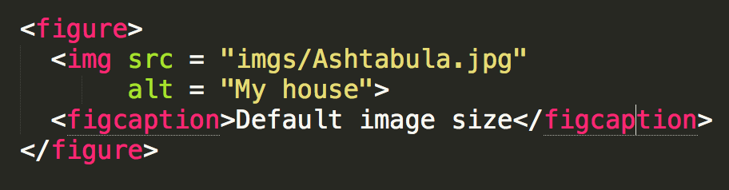
Default Image size

Slide 44
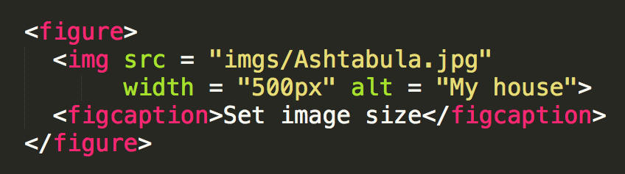
Using Width in Pixels

Slide 45
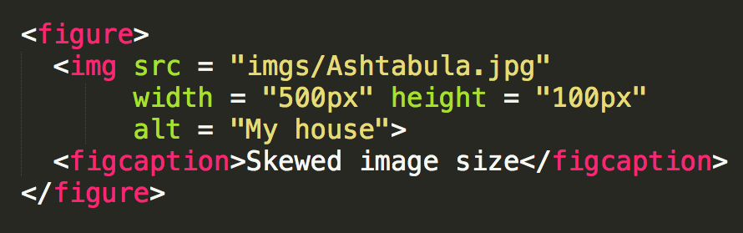
Using Width and Height

Slide 46
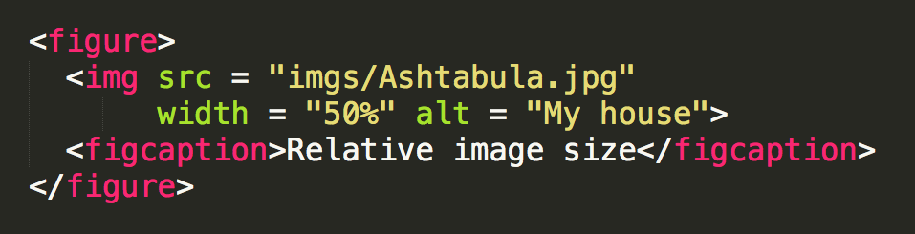
Using Percentages

Slide 47
Favicons
You can put image/logo/icon next to the title of your page (in the tab)
Th following CDN must go in <head> section
<script src="https://kit.fontawesome.com/ffe01cd2d4.js" crossorigin="anonymous"></script>
OR
<link rel="stylesheet" href="https://cdnjs.cloudflare.com/ajax/libs/font-awesome/4.7.0/css/font-awesome.min.css">

Slide 48
More on Font Awesome
Some browsers or platforms may have issues...
So don't worry about it
A link to a CDN (Content Delivery Network) file won't work if you're developing offline.
W3schools also explains font awesome very well.
https://www.w3schools.com/icons/fontawesome_icons_intro.asp

Slide 49
Favicons
<i class="fas fa-thumbs-up fa-5x"></i>
<i class="fas fa-angry"></i>
i stands for icon
<i class="fas fa-angry fa-xs"></i>
<i class="fas fa-angry fa-md"></i>
<i class="fas fa-angry fa-lg"></i>
<i class="fas fa-angry fa-2x"></i>
<i class="fas fa-angry fa-5x"></i>
<i class="fas fa-address-card"></i>
disadvantage: not accessible by default

Slide 50
YOu check how to add
twitter
facebook
pinterest

Slide 51
WOW!! That's a lot you learnt for today
Images
Links
Html Lang
DOM
Various attributes to elements
Font Awesome
Lists
HR
Oh!!we'e reached a point where listing tags we learnt is going to be tiring..... CONGRATULATIONS!

Slide 52
Practise
Practise
Practise
HTML has got a lot of options to explore!!!!

